Slide 1
Introducing CSG
<insert sub-title>

Slide 2
CSG Research
37 years of experience
100,000 interviews per year

Slide 3
Our Growth 1982 - Present
Became member of The INTAGE Group
Joined WIN/ Gallup International
Established in Macau
Established in China (GZ, BJ, SH)
Established in HK
2011
2013
Global network of 50+ independent agencies
Japan No. 1 & Global Top 10 Largest Agency
1982
1994
2008
Our Growth 1982 - 2016

Slide 4
Our Geographical Coverage
Our research network via WIN/ GIA International Association

Slide 5
WEALTH OF EXPERIENCE ACROSS A WIDE RANGE OF ANALYTICS
Research Analytics
Statistical Analysis
Expertise in a full range of statistical analysis including:
Gap analysis, Cluster analysis, Factor analysis multiple, Regression, conjoint analysis, Brand mapping
Value Add
Facilitating Stakeholders immersion sessions, Brainstorming sessions and Insights workshops
Actionable Insights
Bilingual reports available upon requests, Data delivery in a variety of formats, Senior Management presentation
Our Growth 1982 - 2016

Slide 6
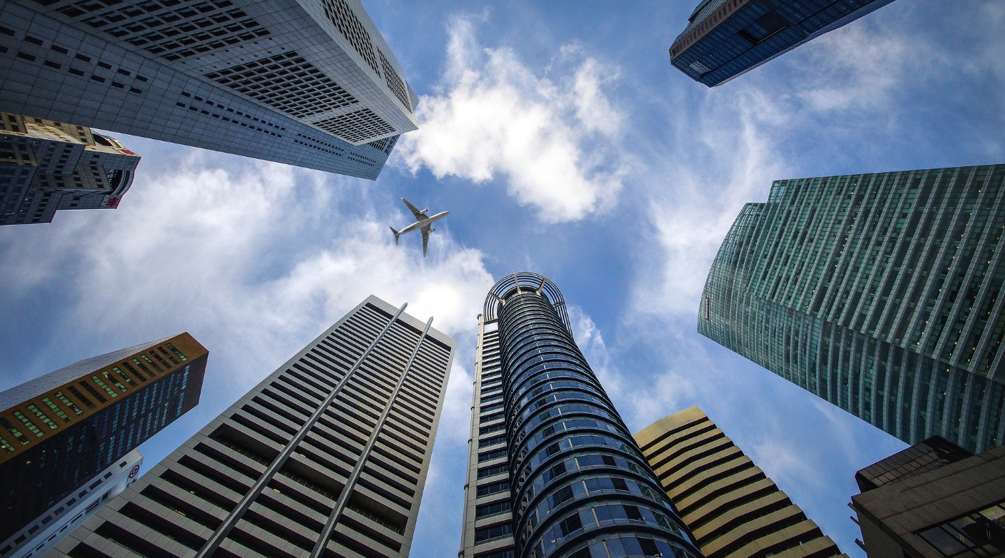
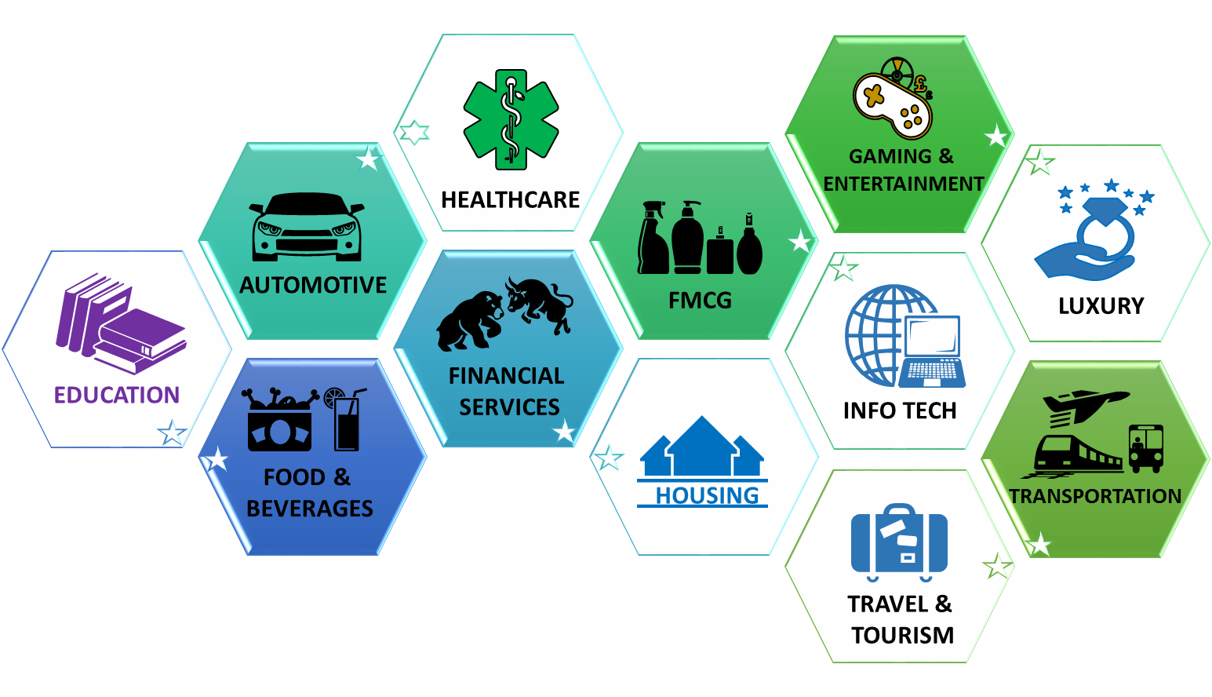
Extensive Knowledge on Wide Range of Industries
Our Growth 1982 - 2016

Slide 7
Research Methodology
Quantitative
Telephone interviews, Web-based interview, Door to door, Street intercept, Central location tests (van, hall), Mail survey. Choice of computer aided & paper interviews.
Qualitative
C-Suite interviews, In-depth interviews (dyad/ paired/ triad), Focus group discussion (full, mini, B2B), Ethnography, Online FGD (chat room).
Retail
Retail audit, Mystery shopping, Transaction survey.
Desk Research & Data Mining
Trend analysis, Gap analysis, SWOT analysis, Text analytics

Slide 8
Our People
50+ Research Professionals in Quantitative and Qualitative Research
88%
Team leaders with 20+ years of consumer insights experience
Staff Satisfaction
2018
300+ interviewers
Supervisors with 10+ years experience
1,000+ mystery shoppers from affluent to mass

Slide 9
The Experts
LAM Tat
Managing Director 30+yr MR experience
Winnie POON Executive Director
15+yr MR experience
Simon TYE
Executive Director
20+yr MR experience
Alice LAU
Executive Director
30+yr MR experience
Robert LI
Executive Director
30+yr MR experience
Raymond SUN
Research Director
30+yr MR experience
Alice TENG
Research Director
20+yr MR experience
ONG Bee Choo
Sr Research Director
20+yr MR experience
Derek YU
Research Director
10+yr MR experience
Denis CHAN
Research Director
10+yr MR experience
Peggy WONG
Research Director
10+yr MR experience
Donna CHEUNG
Research Director
10+yr MR experience

Slide 10
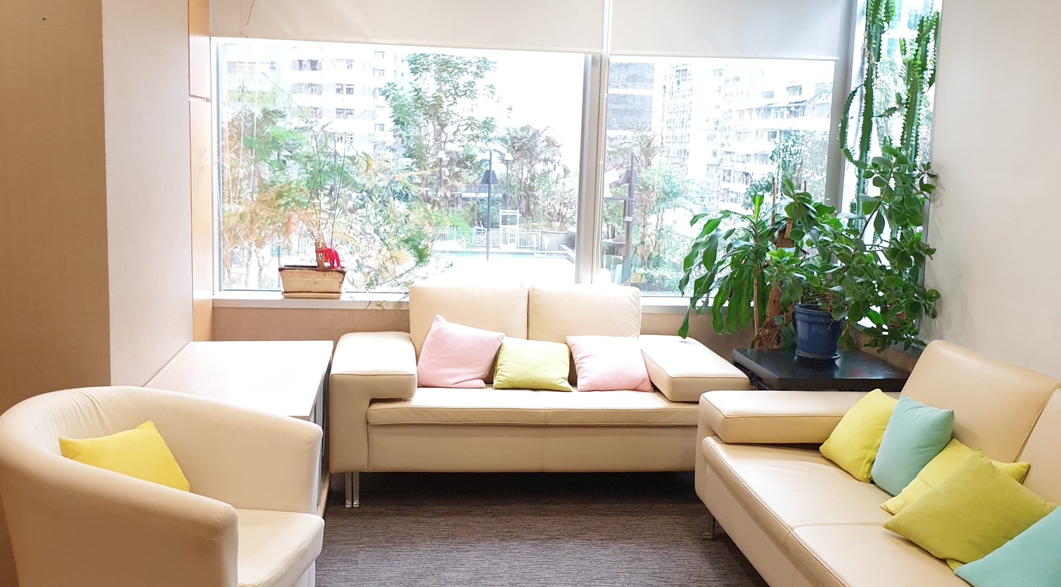
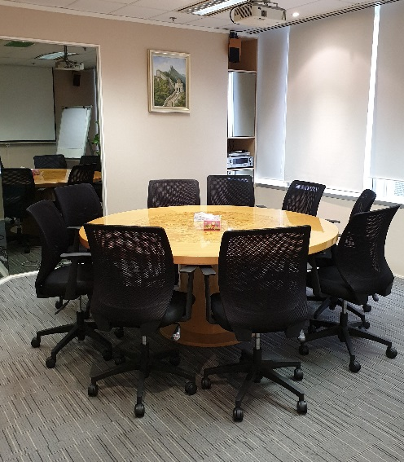
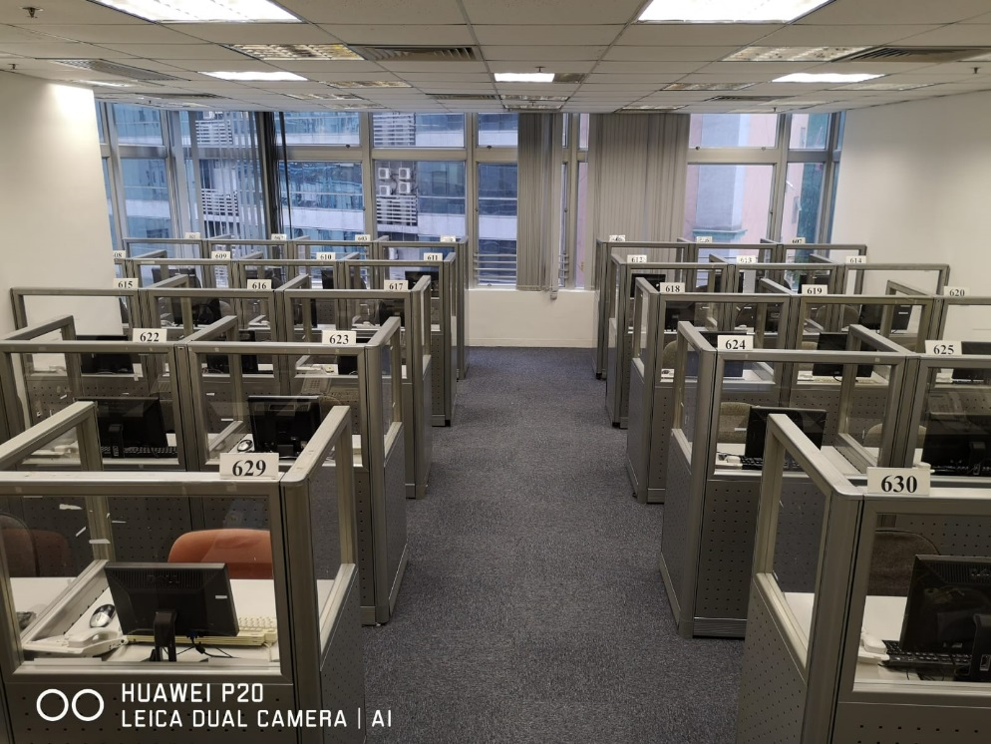
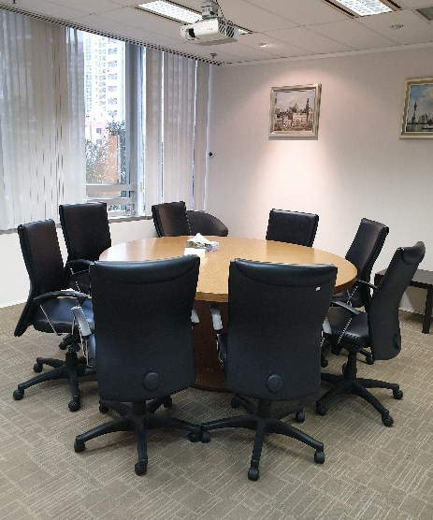
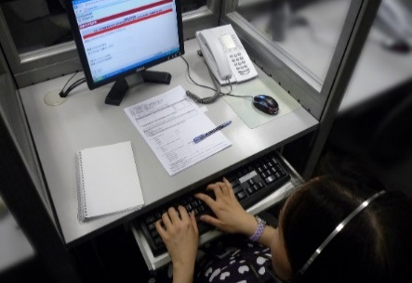
Our In-house Facilities
FGD 1
FGD 2
Qualitative
Video streaming
Audio and video taping
Simultaneous translation
Translation overlay
Quantitative
50+ CATI stations
Data hosting in Hong Kong
Audio recording
On-site monitoring system

Slide 11
We provide
Creative, Actionable Solutions
to Drive Your Growth

Slide 12
d
Branded Solutions
Leveraging INTAGE’s wide range of solutions and partnering with GIA agencies, we have the latest research solutions to address your business needs.
Market Exploration
MyReco
MROC
Product Development
Eye Tracking
Facial Coding
i-Shelf
Brand Loyalty
Brand Compass (Brand Relationship)
SpeedBoard

Slide 13
MyReco
Market Exploration Analytics
MyReco is a diary-style survey utilising a smartphone application which respondents record a variety of moments from daily life that clients wish to learn the most about.
It records consumers’ information exposure, purchase behaviour and usage behaviour when and where it happens – real time!

Slide 14
Eye Tracking
Product Development Analytics
Eye Tracking uses cutting edge line-of-sight technology to accurately track eye movement in retail display, product packaging website browsing, and advertising.
Eye tracking technology enables us to comprehend how consumers navigate products from shelves/ on websites and what are the gap between consciousness and actual behaviour
Benefit of gathering deeper insights into consumer behavior by incorporating conventional surveys.

Slide 15
Facial Coding
Product Development Analytics
Facial Coding analyses minute facial expression to significantly increase insights into the true feelings and perception of the test advertisement.
Based on categorisation of a persons facial muscles (FACS theory) movement, we can gather deep insights into consumer behavior by incorporating conventional surveys.
Six basic emotions are recorded, namely joy, sadness, anger, disgust, surprise and fear.

Slide 16
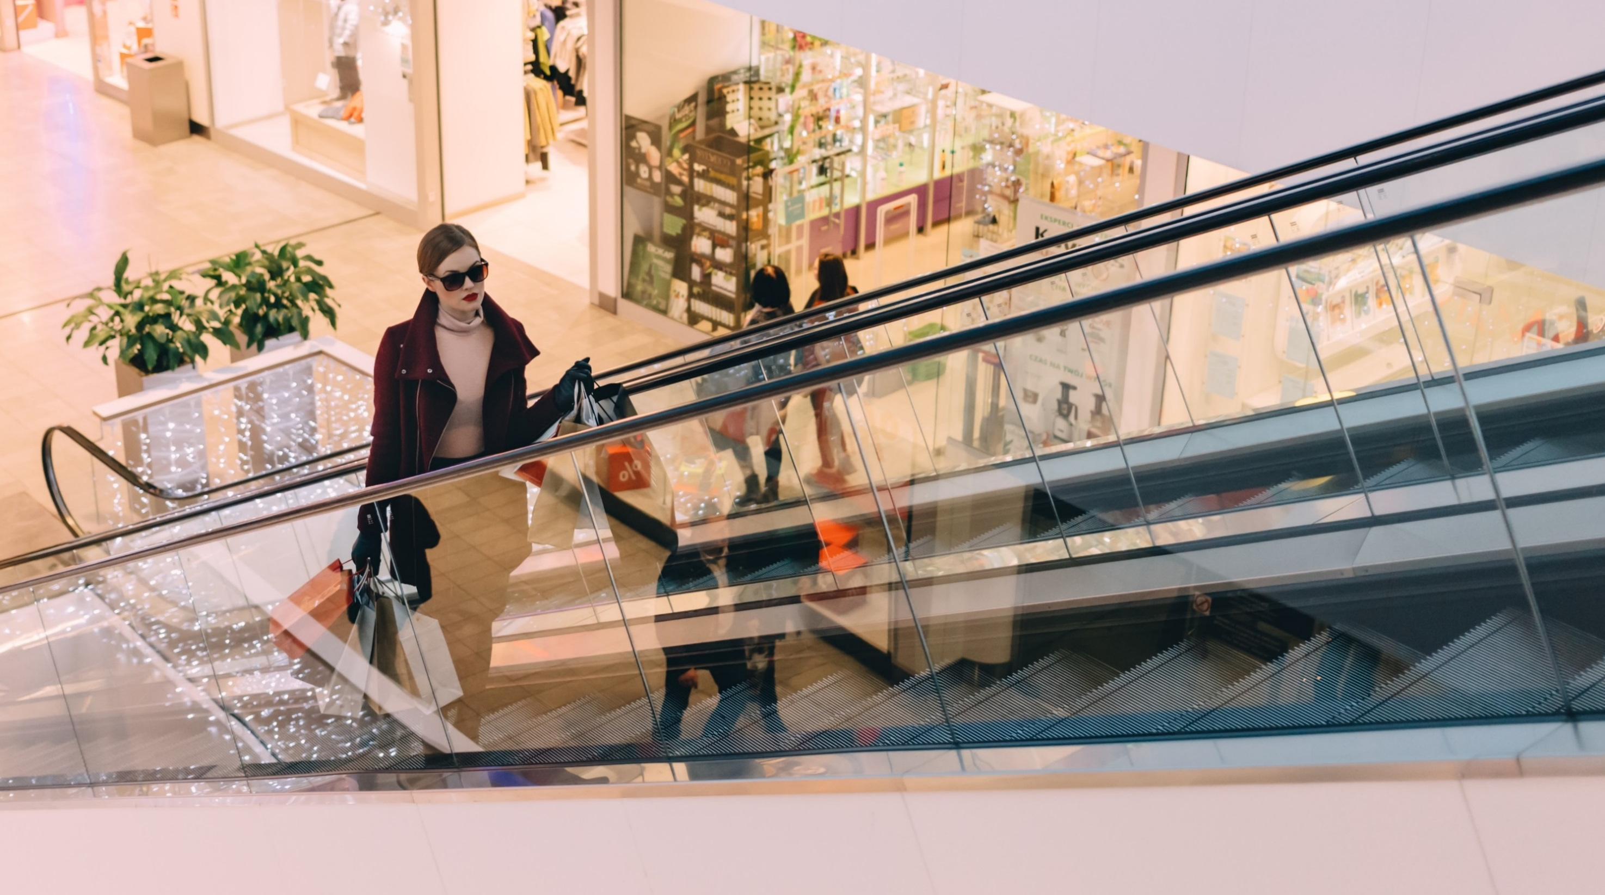
Brand Compass
Brand Loyalty Analytics
Brand Compass (Brand Relationship) is a proprietary analytical tool that measures how strongly consumers are connected with a brand.
Brand Compass enhances your brand performance to drive higher level of repeat purchase and brand recommendation versus your competitors.
Consumers are classified into 4 distinct segments - Rejecters, Neutrals, Likes, and Bonds based on their Brand Relationship and Attitudinal Scores.

Slide 17
i-Conjoint
Computer Aided Analytics
i-Conjoint involves analytics that clarifies the extent to which consumers favor each of the elements making up a product (its attributes/levels).
i-Conjoint enables you to analyze a maximum of 8 attributes / 7 levels.
It replicates actual shopping conditions with the online survey being very user friendly
A key deliverable is the simulation analysis that forecasts how mind share will change when product concept combinations are changed.

Slide 18
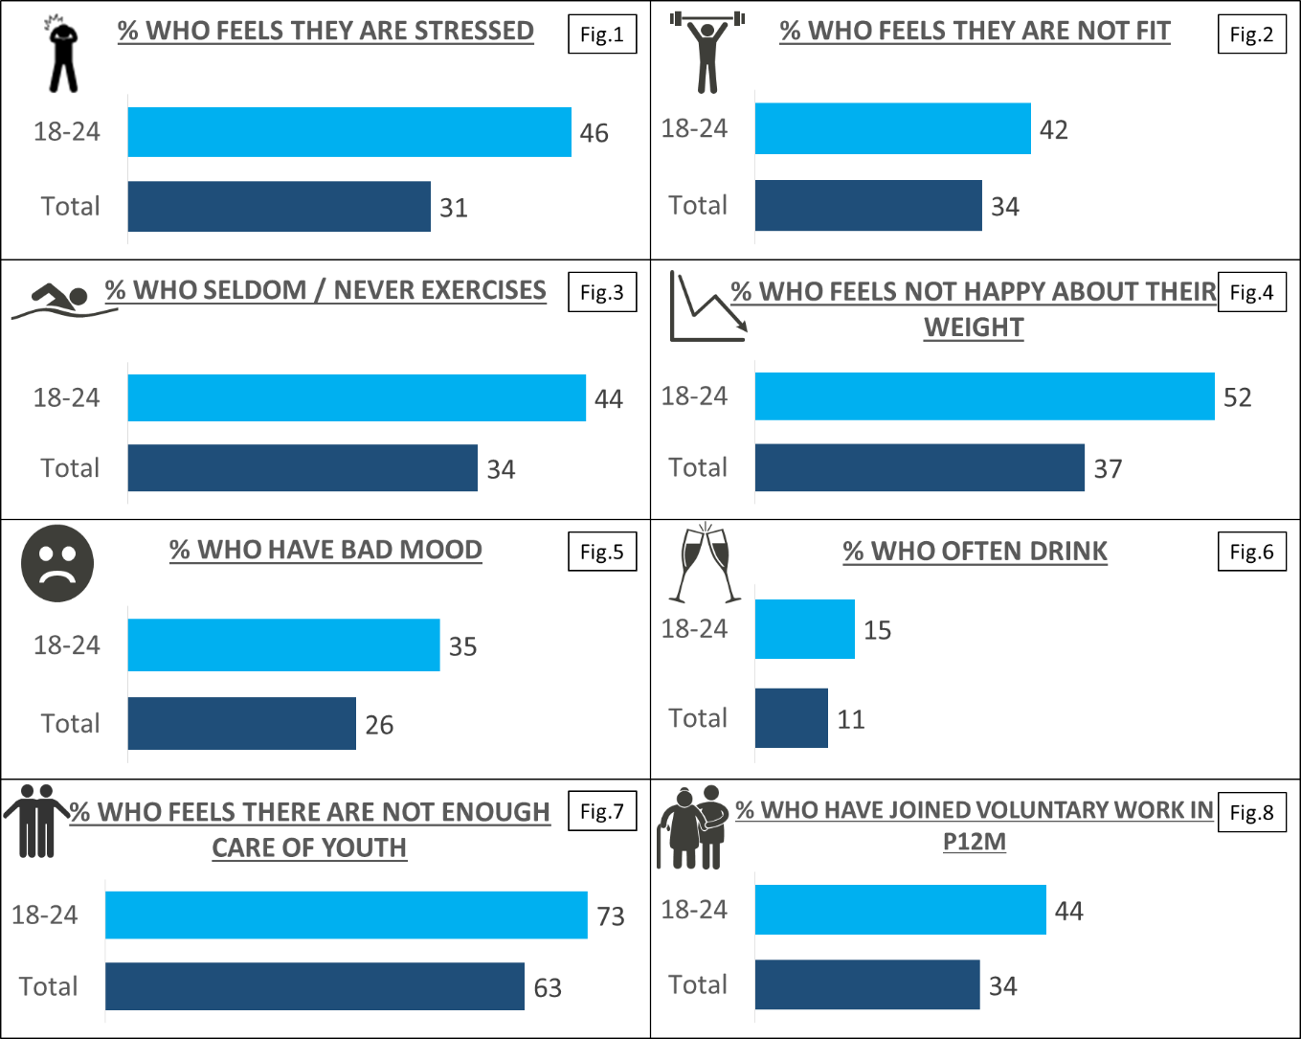
Intellectual Capital – Our Publications
We publish research papers and findings on hot issues
HONG KONG, Thursday, 21st March 2019, The Annual Happiness Index Study from CSG HONG KONG found that 46% of youth aged 18-24 in Hong Kong are suffering from stress (see Fig. 1):
The research also found that young people rated low in their physical health, mental health and fitness.
More than 70% of them felt that there was not enough care for youth of Hong Kong.
The high stress level has serious impacts on youth’s health, both physically and psychologically.
IMPACTS ON PHYSICAL HEALTH
42% of Hong Kong youth (18 – 24 years old) feel that they are not fit (see Fig. 2) and this is higher than 34% of all adults surveyed. As a result of a stressful life, 44% of 18-to-24-year olds said that they “had very little exercise” or “never exercised” in the past year (see Fig. 3), a number which was higher than the average (34%).
IMPACTS ON PSYCHOLOGICAL HEALTH
Other than the physical aspect, it is not surprising to find in the survey that more than one-thirds (35%) of youth claimed that they had “very poor” or “quite poor” mood (see Fig. 5), this is about 10% more than the Hong Kong general population (26%). This is definitely a concern when one-third of the youth population are suffering from poor psychological health.
… refer to CSG website for full research findings.

Slide 19
CHINA LUXURY FORECAST 2019
Average spend on leisure trip in N12M
Average spend on last leisure trip
Average spend on shopping on last trip
HK$
55,000
(2018: 82,000)
HK$
20,000
(2018: 24,000)
HK$
8,000
Hong Kong Travellers
RMB
70,000
(2018: 74,000)
RMB
27,000
(2018: 24,000)
RMB
13,000
China Travellers

Slide 20
What Our Clients Says
100%
“(The team) has met our expectations and shown their ability to deliver their promise and co-ordinates well with the different countries … and with competitive pricing, it was an easy choice to select CSG”
Ricoh Asia Pacific
“The team fully understands our business and our brands’ DNA. The quality of respondents and moderators what we are looking for. They have a wealth of experience in the luxury market and able to share that with us”
Hong Kong Land
Satisfaction
2018
Testimonials

Slide 21
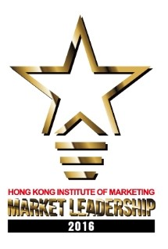
Industry Recognition
2015
Bronze Award 2018
Bronze Award 2017
Local Hero Award 2018
Local Hero Award 2017
Market Leadership in Market Research Agency 2015
Market Leadership in Market Research Agency 2016

Slide 22
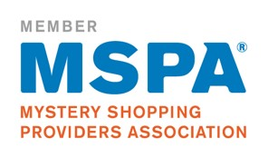
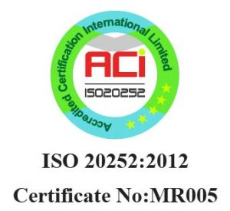
Our Quality Assurance
ISO 20252:2012 certification by Lloyd’s Register Quality Assurance Ltd. (HK headquarters’ QMS)
ISO9001:2008 certification
ISO accreditation by UKAS (The United Kingdom Accreditation Service)
ISO accreditation by ANAB (The American National Standards Institute – The American Society for Quality National Accreditation Board)
Member of GIA (Worldwide Independent Network)
Member of CMRA (China Marketing Research Association)
Member of MSPA (Mystery Shopping Providers Association)
Member of HKGCC (Hong Kong General Chamber of Commerce)
Comply with ICC/ESOMAR International Codes of Practice (European Society for Opinion and Marketing Research (ESOMAR); International Chamber of Commerce (ICC))

Slide 23
Thank you

