Slide 1
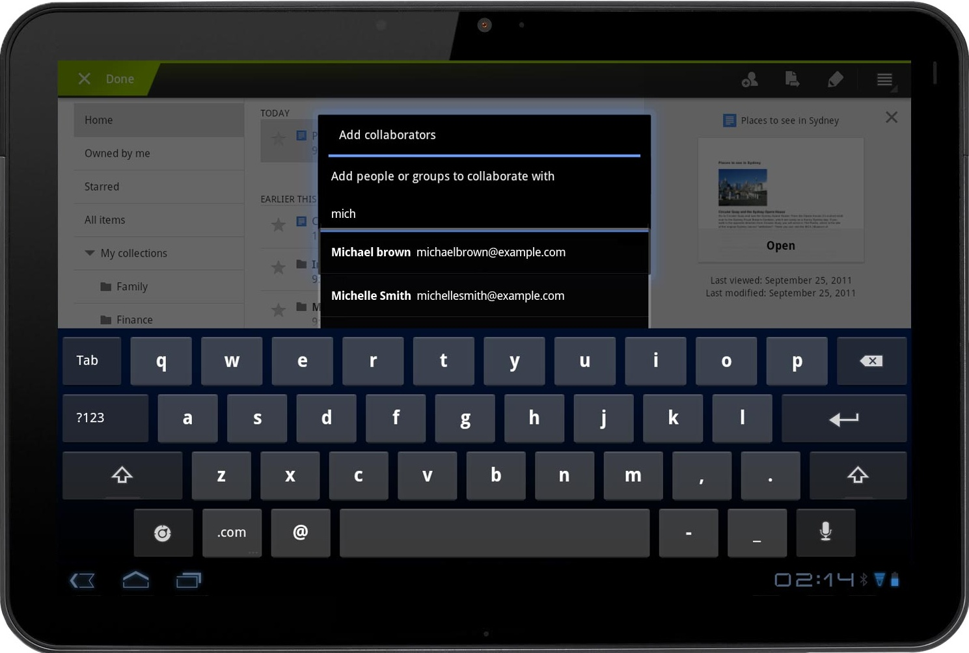
Boost Your Sales with 3-in-1 System
Mobile Expert System (Sales Gameplan)
Global Skill-Based Workshop
Online 180º Assessment
First Public Program April 2-3, 2014

Slide 2
Mobile Expert System
(Sales Gameplan) includes:
Communication Style Profiling System
Listeners’ Profiling History
Contacts
Notes
Calendar
Weather
Google Map
iPad & Android Phones
RELIABLE!
Based on Persona GLOBAL®’s Communication Styles instrument validated with over 1.4 million users in more than 60 countries, this application provides key trust building messages for successfully influencing your listener.
Available in Chinese & English
FAST!
See your results in less than 1 minute. An unique, practical resource designed for coaches, mentors and managers who need to build long-term trust based relationships.
EASY!
An effective tool for you to be a Persuasive CommunicatorTM. Anytime. Anywhere!
For more details, please contact Ms. Winnie Lo (e: winnie.lo@csg-worldwide, t: 2591 3576)
iPad is a registered trademark of Apple, Inc. Android and Google MapTM are registered trademarks of Google, Inc.

